Slide 1
Spring Industry Leadership and Proof Points

Slide 2

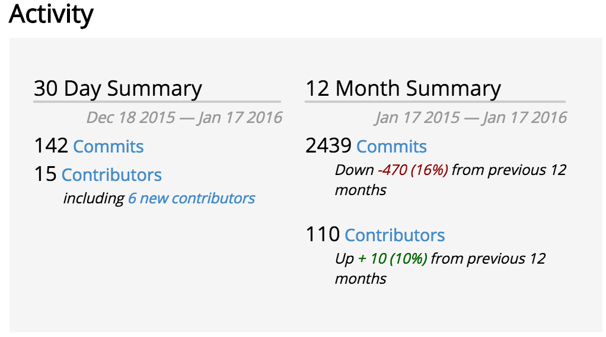
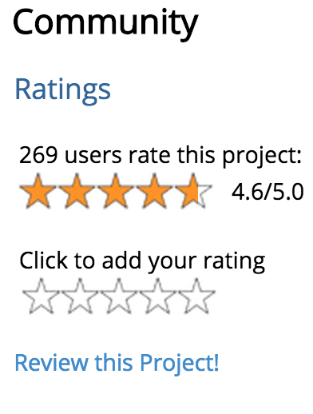
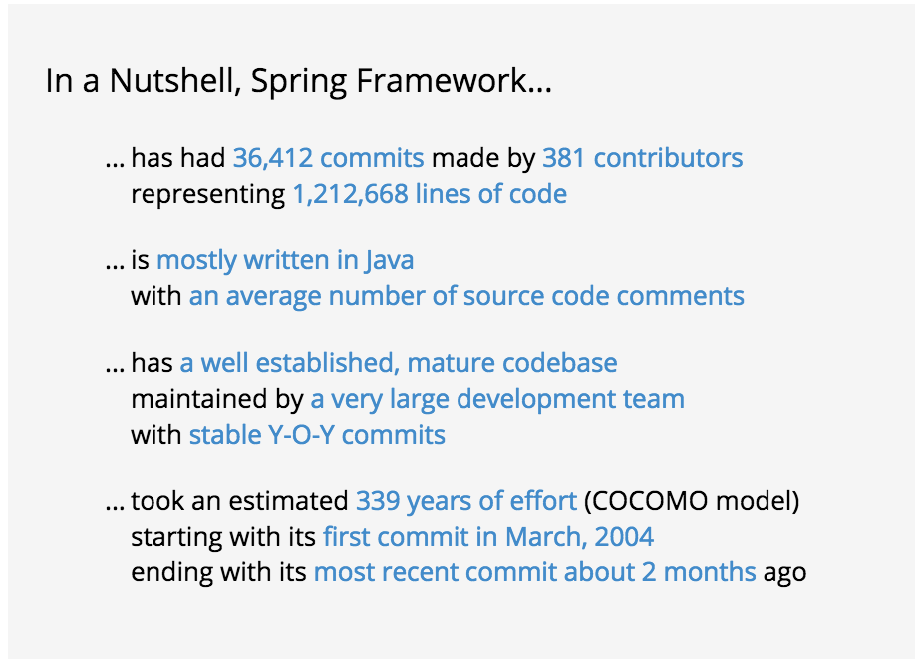
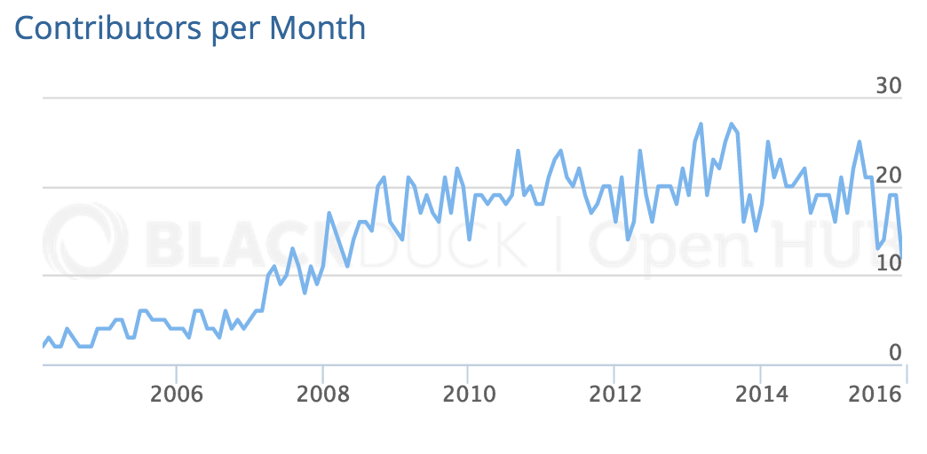

Spring at a Glance
Pivotal Software Inc employs the majority of Spring committers

Slide 3


Innovation Speed in Java WINS
“Velocity on the JVM is the Killer App”
Andy Glover (Netflix Cloud Ops) @ SpringOne2GX 2014 Keynote – early Spring Boot adopters
Youtube Link to Keynote Video
Notes:
Java is the #1 programming language today, but it’s been traditionally been more difficult to develop at earlier stages of an application’s lifecycle vs. dynamic languages like Ruby, PHP, Python etc. After trying Ruby and Node.js, Netflix realized they needed the performance, stability, concurrency of the JVM for their application to service an exploding level of traffic, but was having trouble finding the right RAD capability in Java to give them the development velocity they wanted.
Oh, and type safety, while not specifically mentioned in the netflix keynote speech, is also something most developers appreciate about Java – it makes debugging easier.

Slide 4
Spring Boot Adoption
Monthly Maven downloads
4.2M
Source: oss.sonatype.org

Slide 5
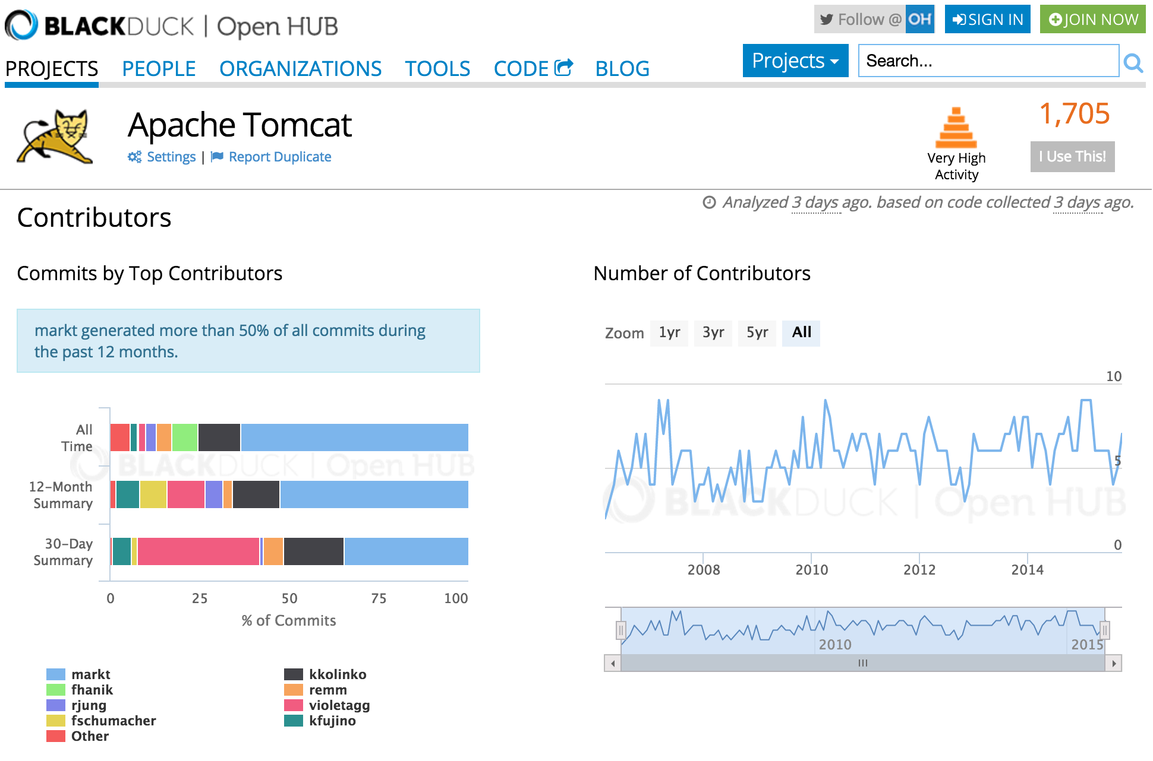
Apache Tomcat LEADERSHIP
Notes:
Mark Thomas and Filip Hanik are Pivotal employees
Pivotal has generated 70% of the lifetime commits to apache tomcat, tcServer heritage began with Covalent acquisition many years ago
In short, Pivotal is more “tomcat” than any other IT vendor in the market and has been for some time.
Apache Tomcat is THE marketing leading lightweight servlet engine / web server / application server, and is the basis for the Cloud Foundry Java buildpack – e.g. it’s what get automatically configured inside a VM/Container to run an app developer’s Java/Spring code.

Slide 6

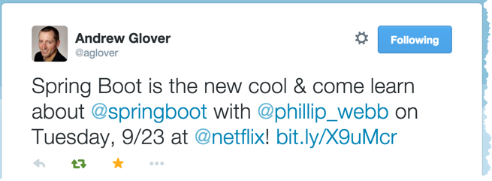





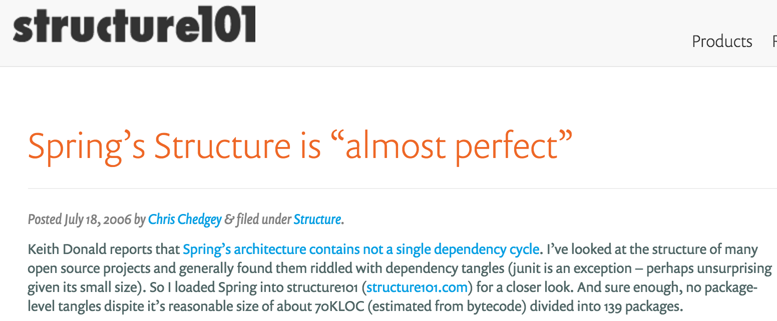

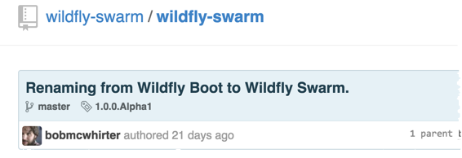
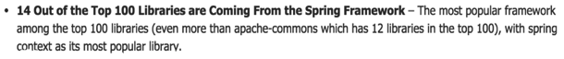
Industry LEADERSHIP
DZone Enterprise
Integration survey
market leader 2014
Notes:
Java code geeks: http://www.javacodegeeks.com/2015/04/we-analyzed-60678-libraries-on-github-here-are-the-top-100.html
Structure 101: https://structure101.com/2006/07/springs-structure-is-almost-perfect/
http://spring.io/blog/2014/11/12/pivotal-recognized-in-dzone-s-2014-guide-to-enterprise-integration

Slide 7
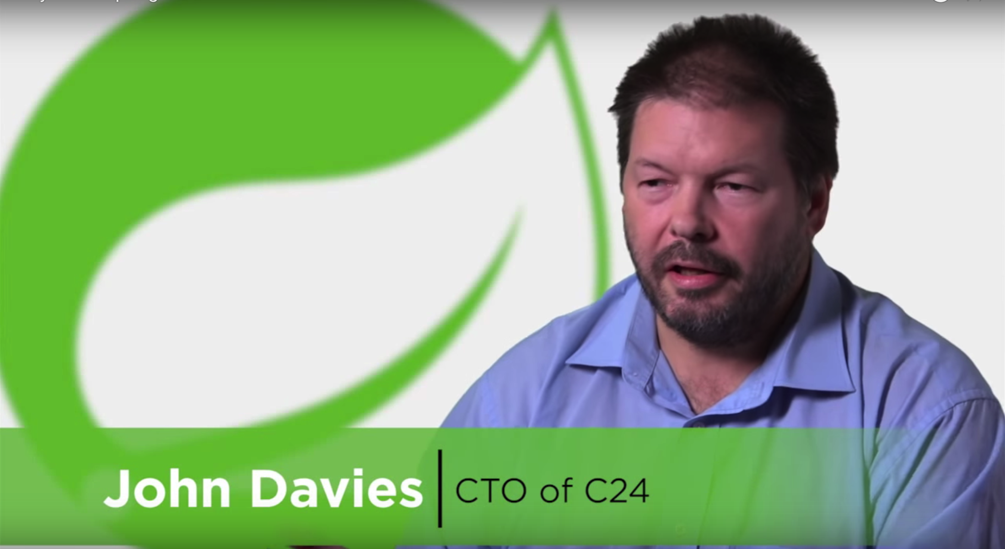
4 Minute Video: Why Google, New Relic, WestPac & eHarmony, all use Spring
Notes:
http://www.youtube.com/watch?v=qoA_MAvM7p8

Slide 8
Appendix

Slide 9
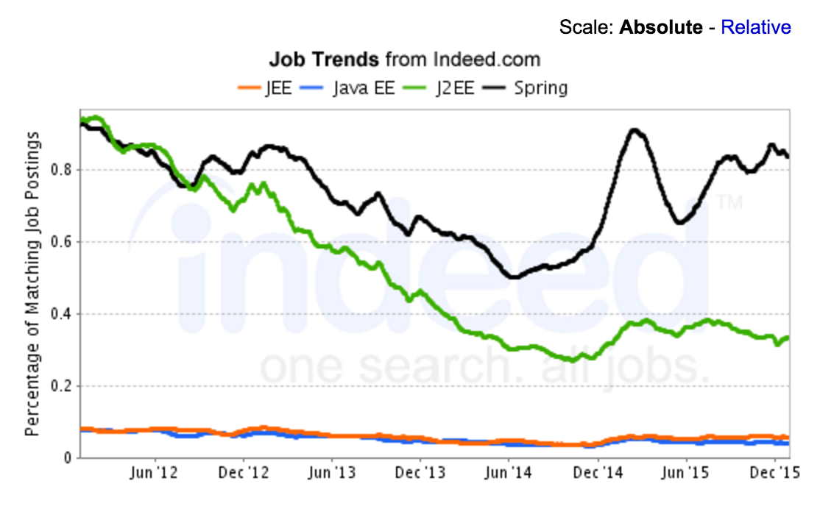
Spring: More popular than Java EE by # of jobs
Source: Indeed.com, world’s largest job site
http://www.indeed.com/jobtrends?q=JEE%2C+J2EE%2C+%22Java+EE%22%2C+Spring&l=
March 2016
Notes:
Source:
Indeed.com, world’s largest job site
http://www.indeed.com/jobtrends?q=JEE%2C+J2EE%2C+%22Java+EE%22%2C+Spring&l=
March 2016

Slide 10
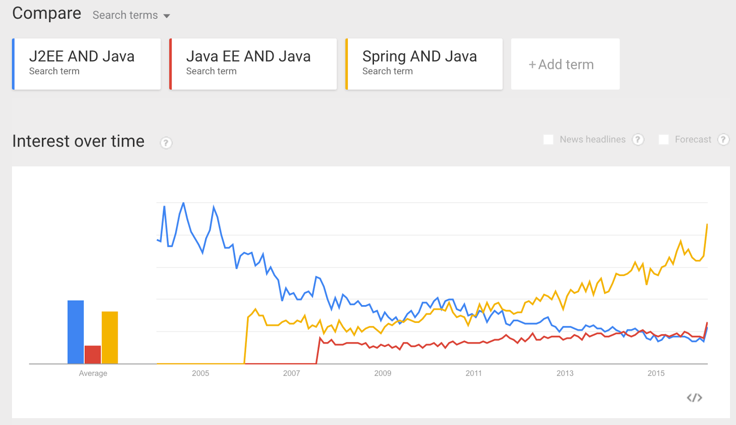
Spring: More popular than Java EE by # of searches
Source:
http://www.google.com/trends/explore#q=J2EE%20AND%20Java%2C%20Java%20EE%20AND%20Java%2C%20Spring%20AND%20Java&cmpt=q&tz=Etc%2FGMT%2B8
Notes:
Source:
http://www.google.com/trends/explore#q=J2EE%20AND%20Java%2C%20Java%20EE%20AND%20Java%2C%20Spring%20AND%20Java&cmpt=q&tz=Etc%2FGMT%2B8
March 2016

Slide 11
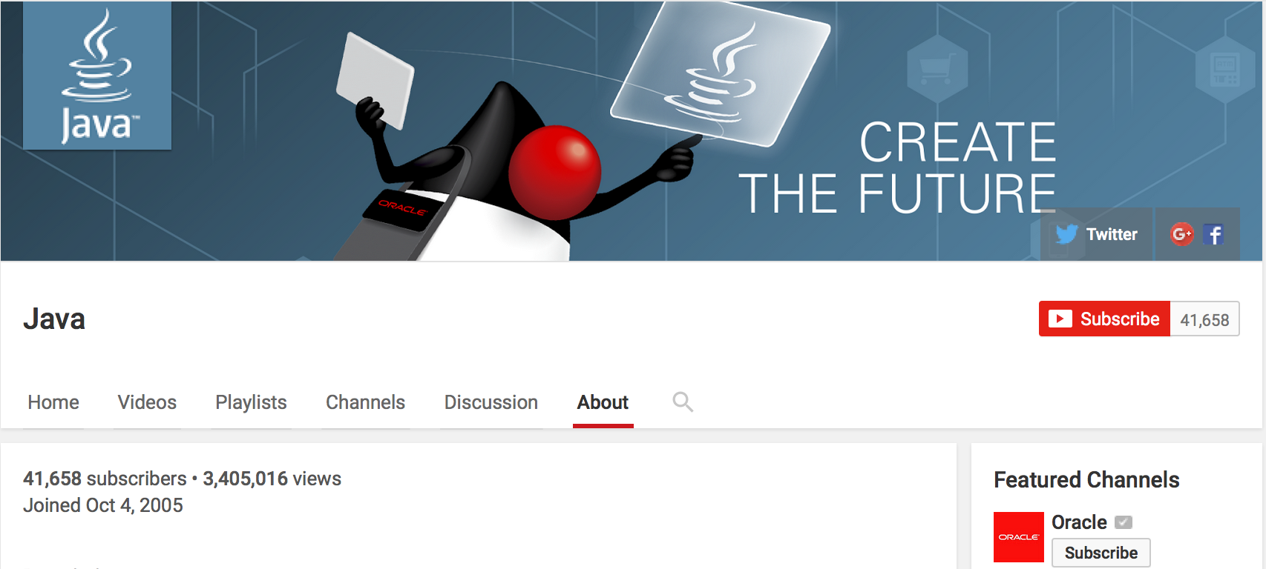
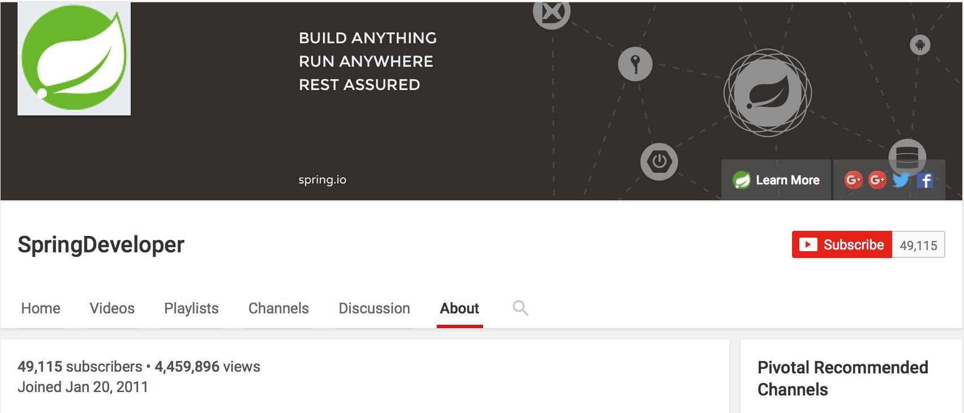
Spring: More popular than Java channel (!) by # of video subscribers & views
Sources:
https://www.youtube.com/user/SpringSourceDev/about
http://www.youtube.com/user/java/about
March 2016
Notes:
Sources:
https://www.youtube.com/user/SpringSourceDev/about
http://www.youtube.com/user/java/about
Note: Java EE YouTube channel does not exist

Slide 12
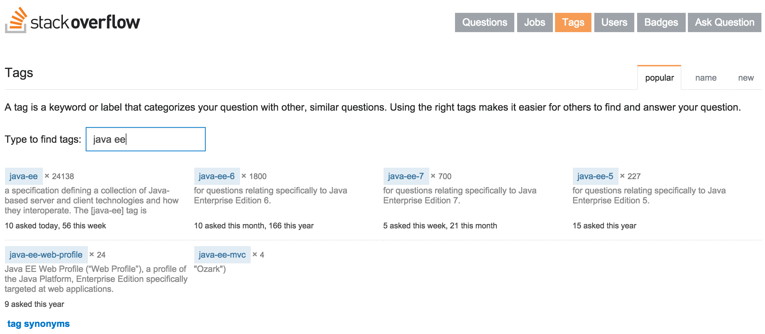
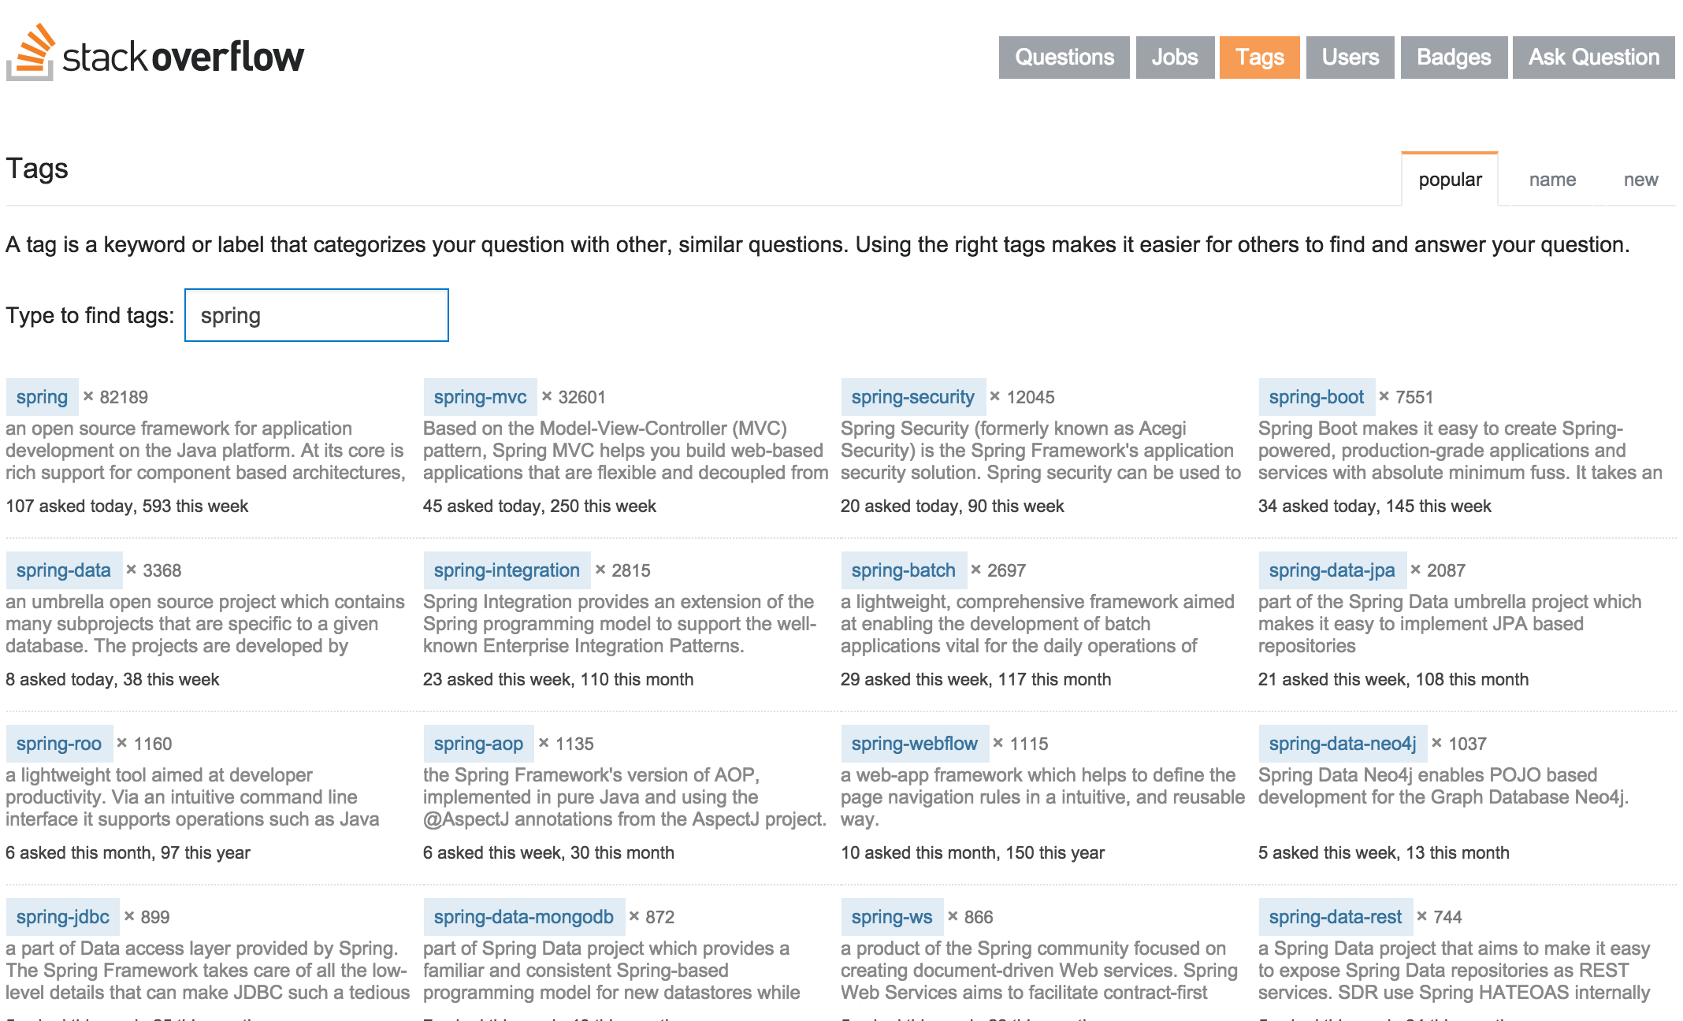
Spring: 3x more SO questions tagged than Java EE
Notes:
Sources:
http://stackoverflow.com/questions/tagged/spring
http://stackoverflow.com/questions/tagged/java-ee
March 2016
Bonus:
Check out the low interest in Java EE 6/7, the current versions:
http://stackoverflow.com/questions/tagged/java-ee-6
http://stackoverflow.com/questions/tagged/java-ee-7

Slide 13

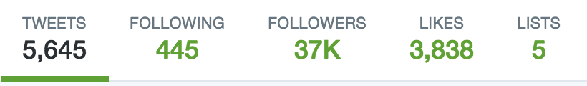
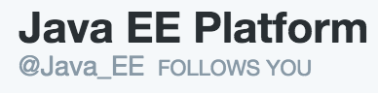
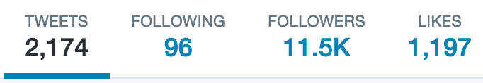

Spring: More popular than Java EE by social media
Notes:
Sources:
twitter.com/springcentral
twitter.com/java_ee

